Slide 1
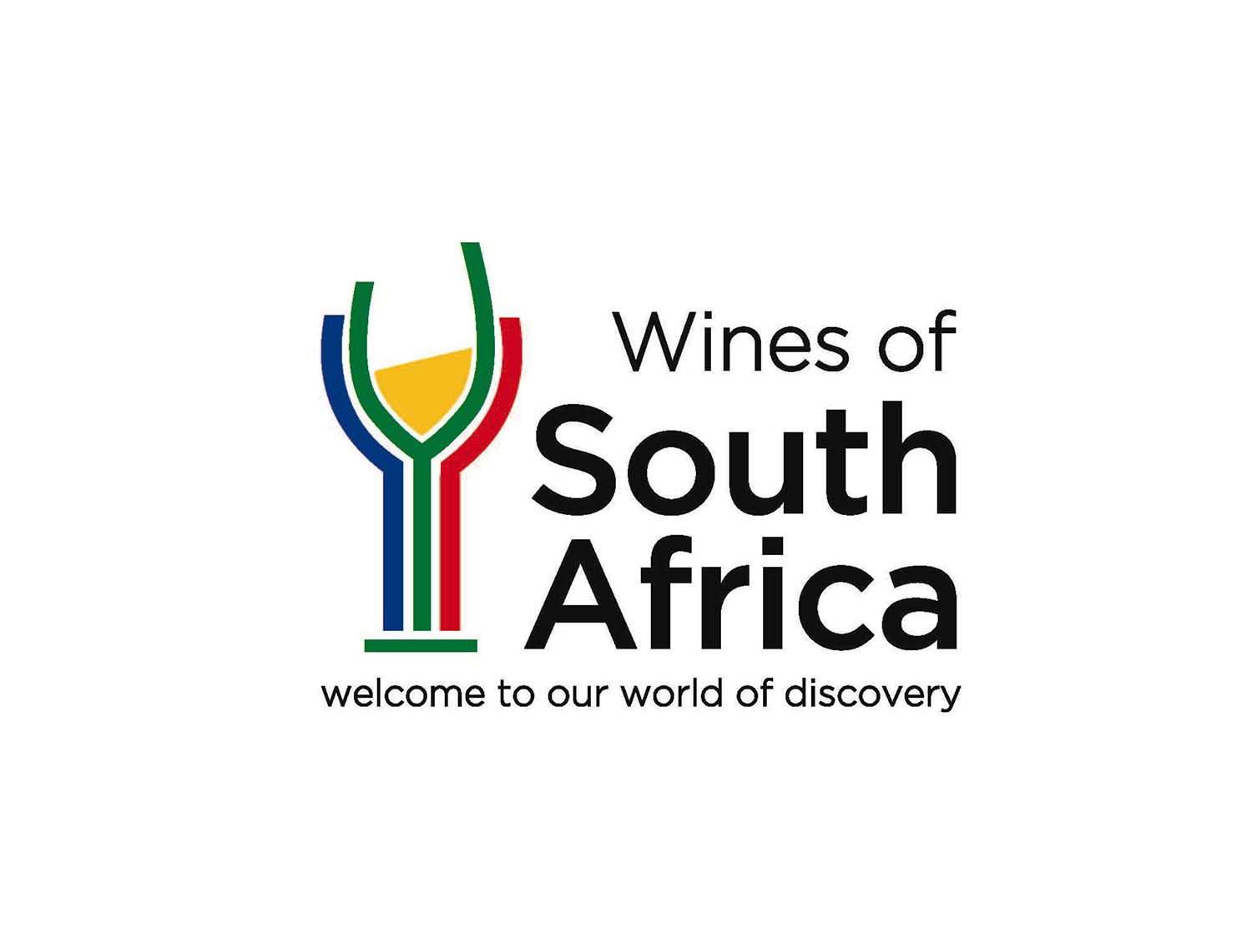
WOSA
SAUVIGNON BLANC

Slide 2
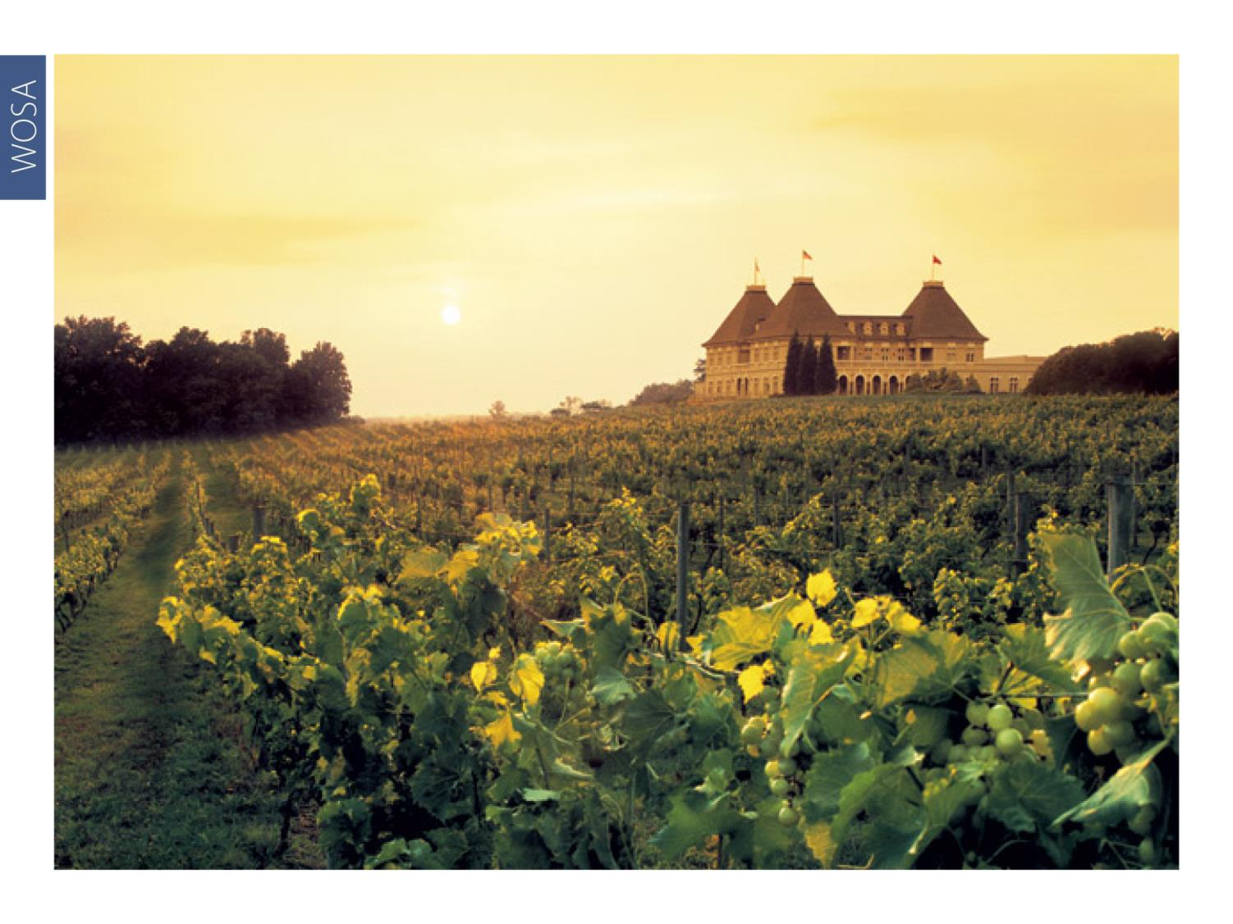
WOSA
Notes:
Extensively planted in France in the 18th century, Sauvignon Blanc has now regained popularity and considerably increased its share of plantings globally.

Slide 3
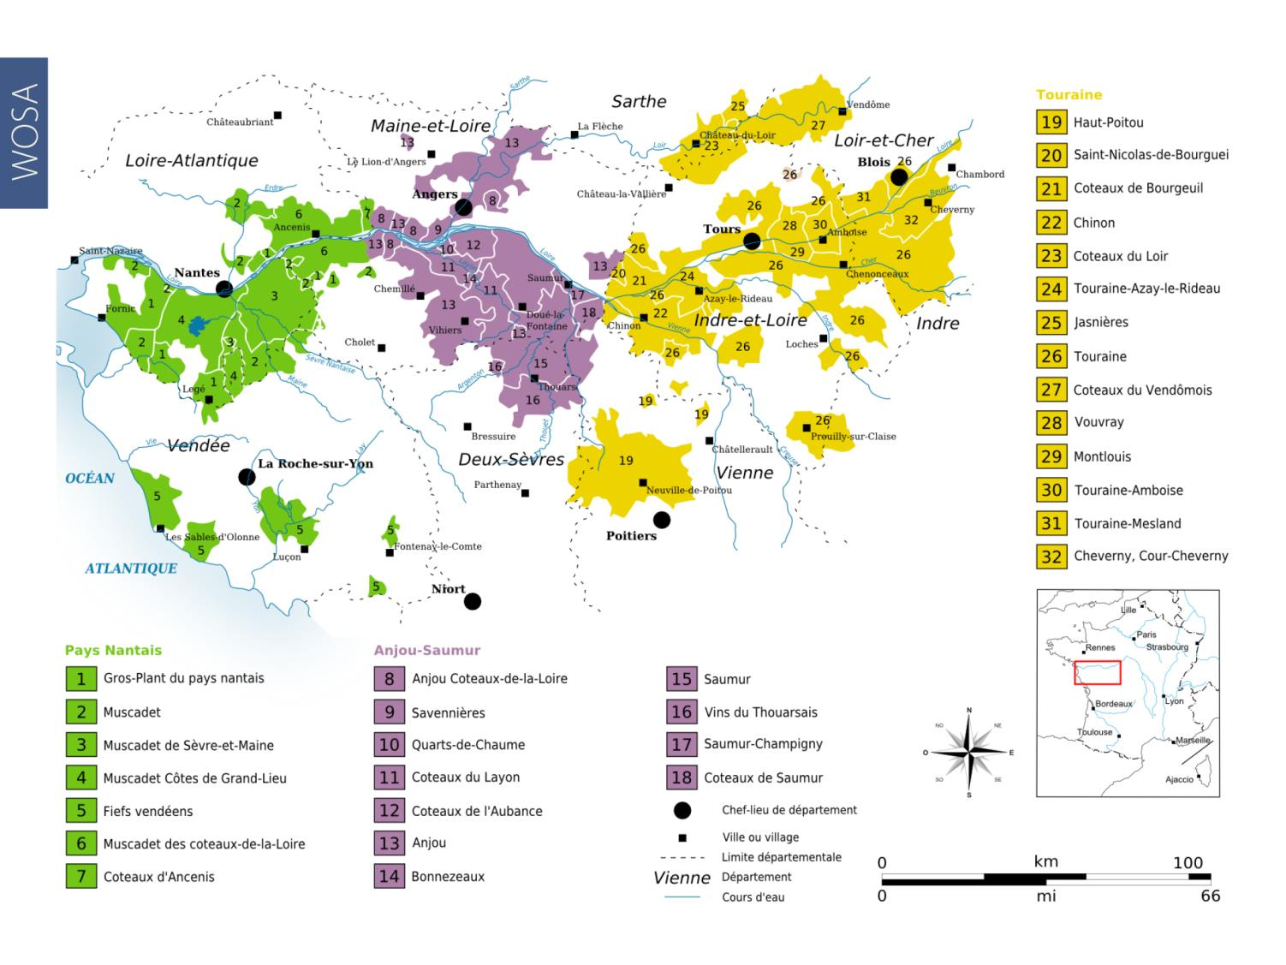
WOSA
Notes:
Sauvignon is most readily associated with the eastern Loire region, which is known for its classic crisp, dry Sancerre and smoky Pouilly-Fumé.

Slide 4
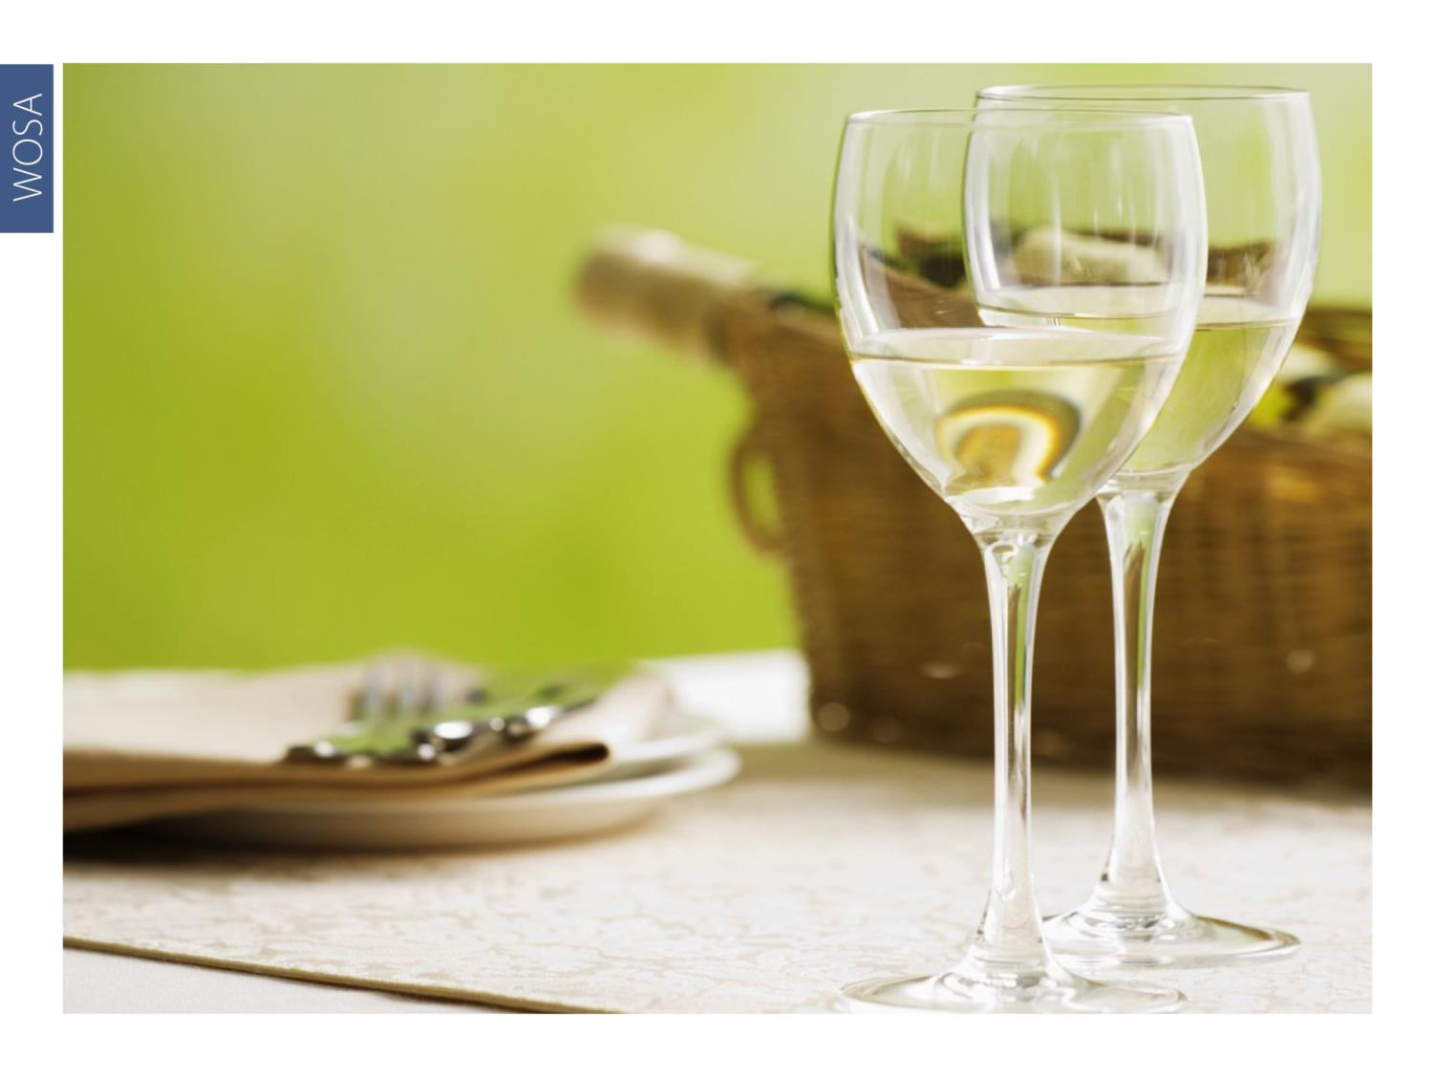
WOSA
Notes:
In combination with Sémillon, these grapes also produce some of the most exceptional white wines of Bordeaux, including the driest Graves and the sweetest Sauternes.

Slide 5
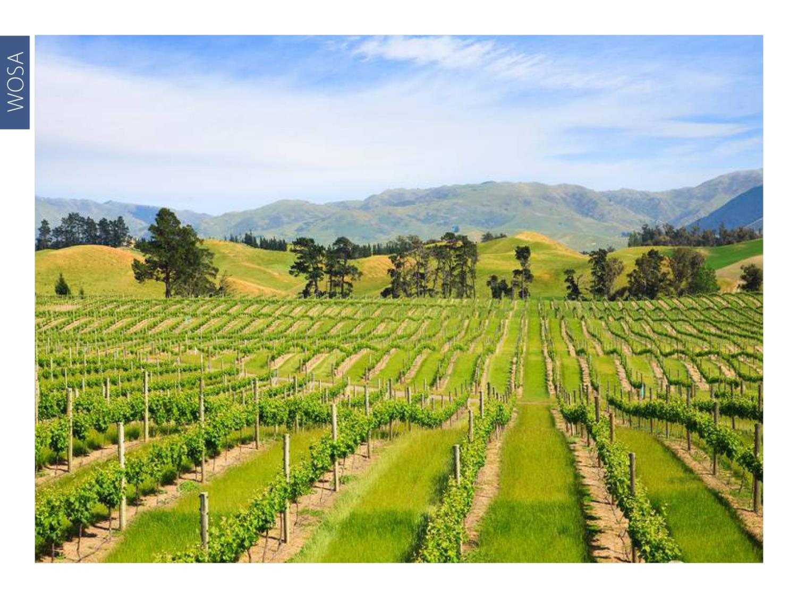
WOSA
Notes:
In the 1980s, the distinctive Sauvignons from New Zealand helped restore the variety’s fashionability and put the country on the world wine map.

Slide 6
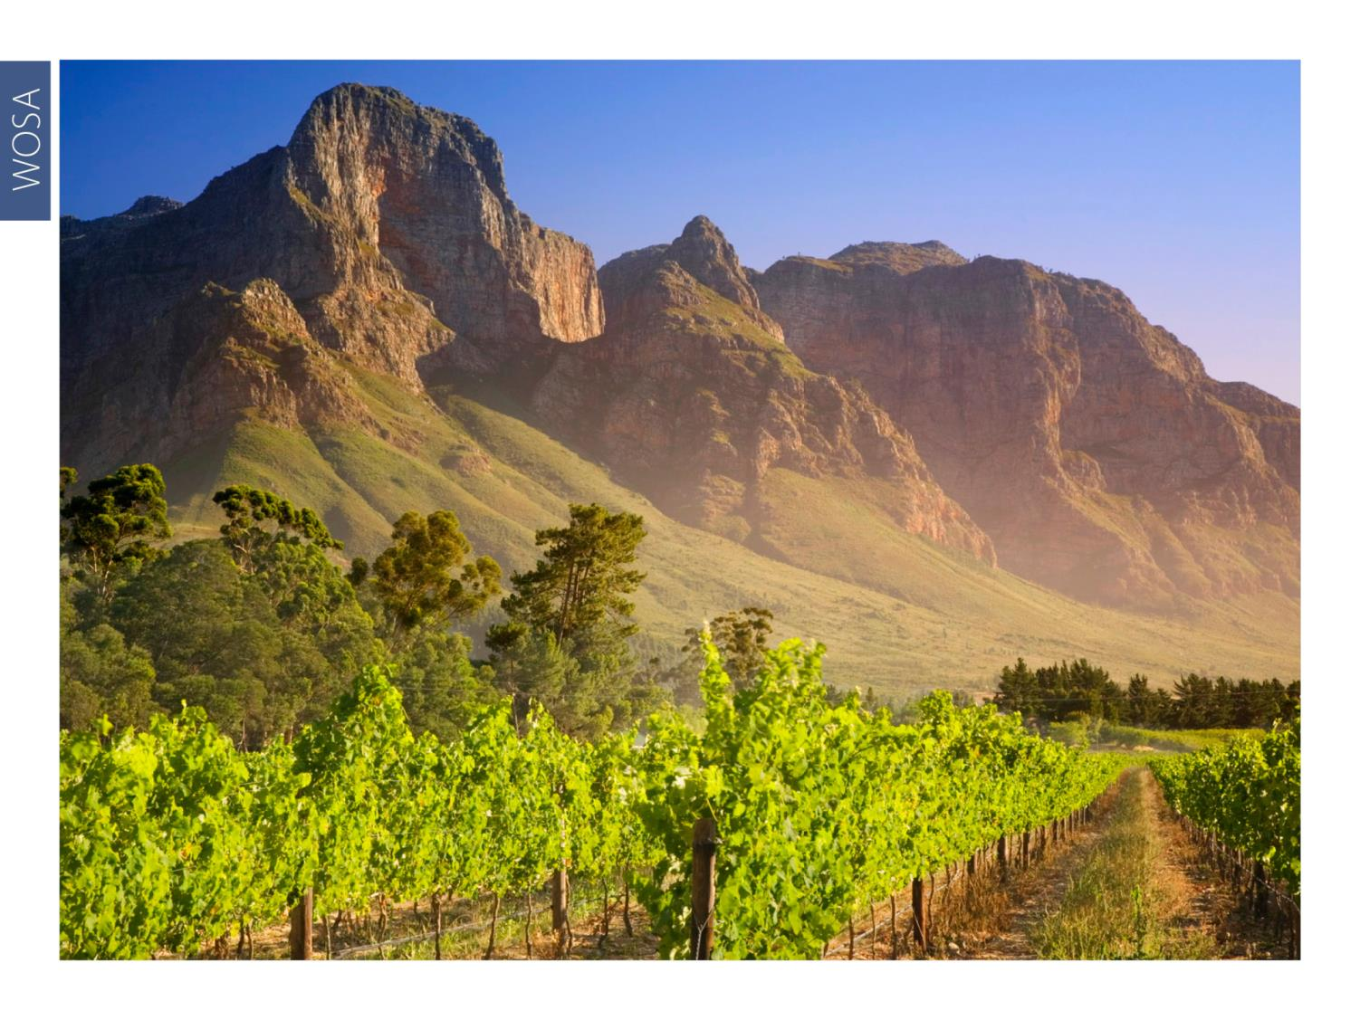
WOSA
Notes:
In South Africa, plantings were relatively small in the 1920s but increased from around 1980.

Slide 7
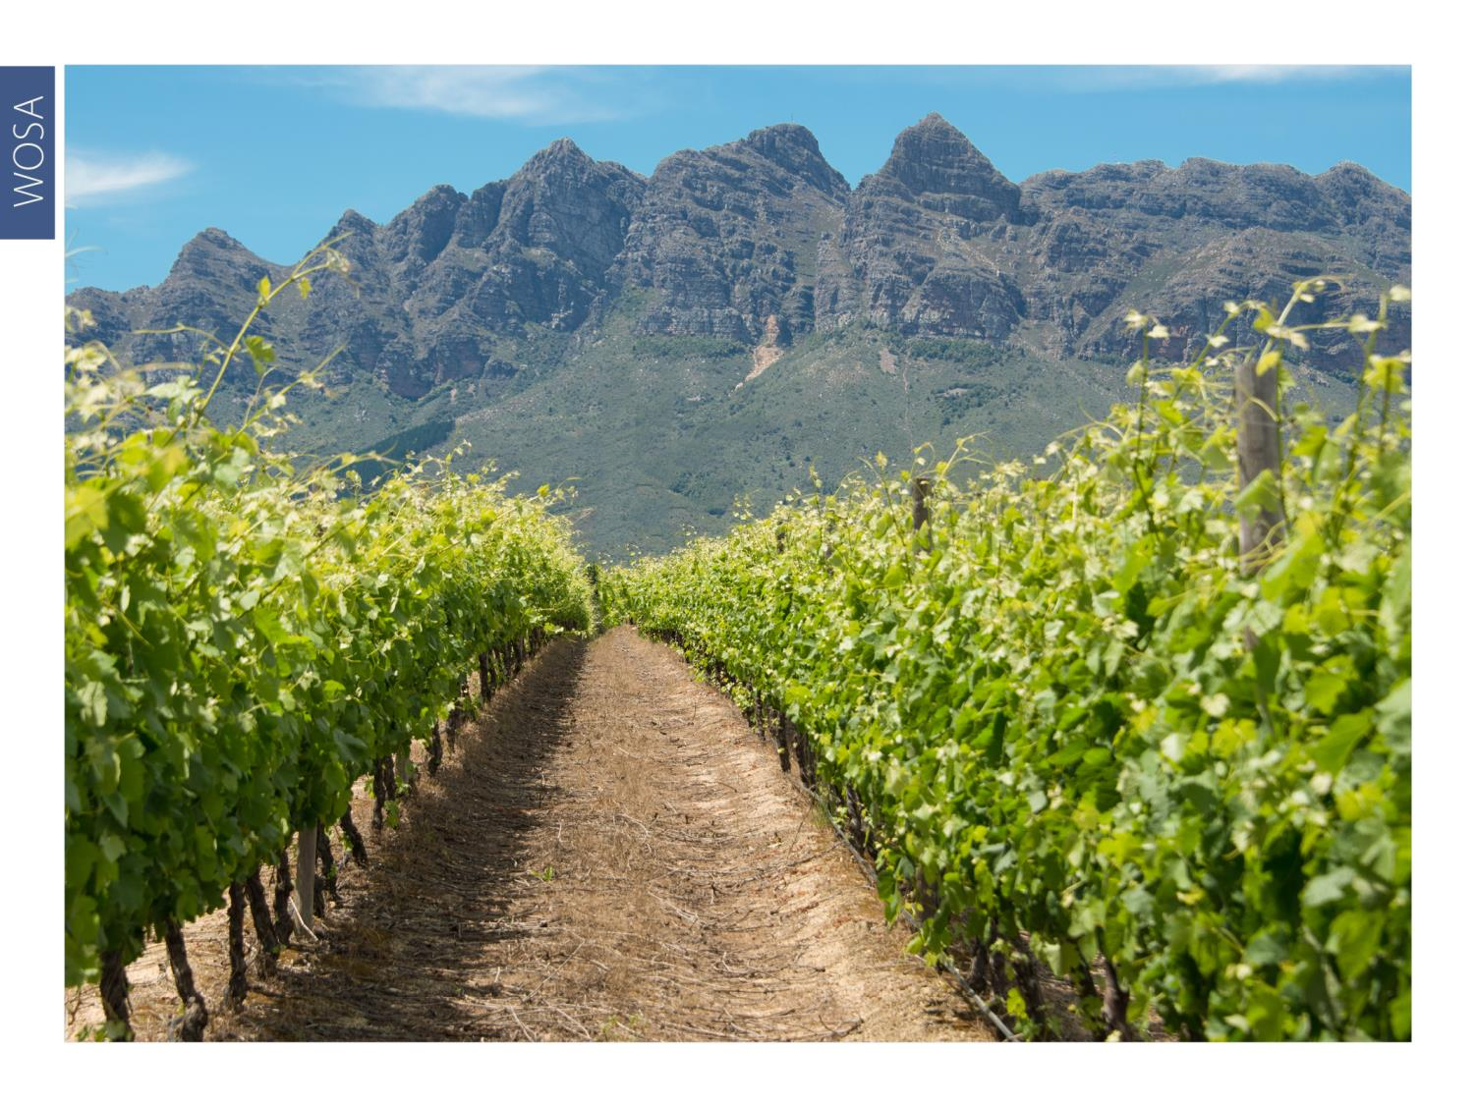
WOSA
Notes:
Much research has been done into the effects of sunlight, canopy management and site selection on the flavour composition of the wines.

Slide 8
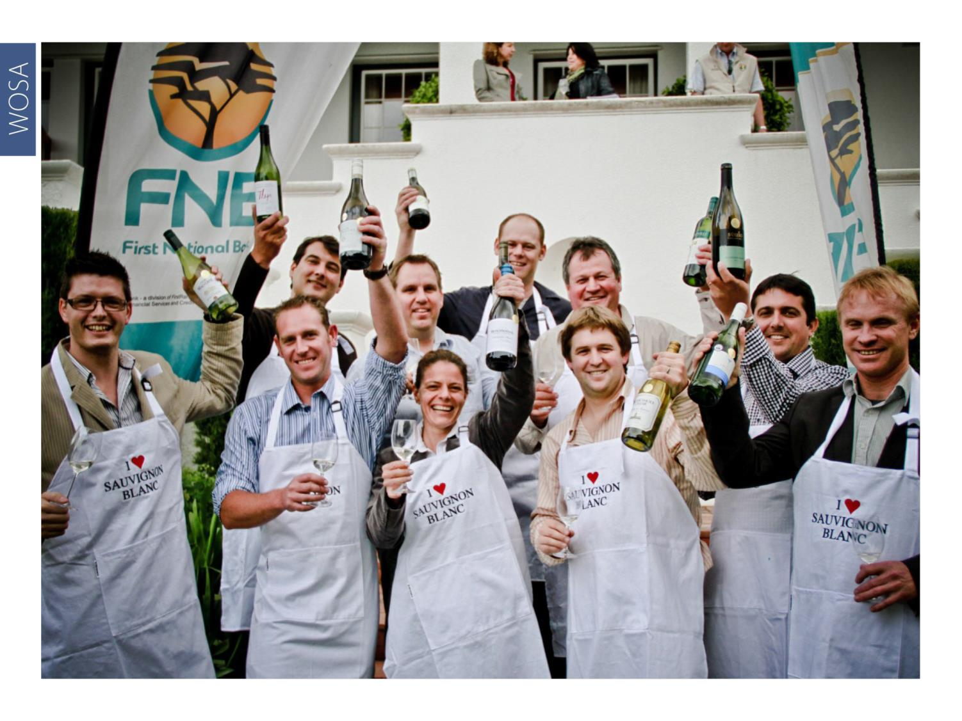
WOSA
Notes:
The annual Top 10 Sauvignon Blanc Competition has been held under the auspices of the Sauvignon Blanc Interest Group (SBIG), now called Sauvignon Blanc South Africa, since 2011. Visit www.sauvignonblanc.com for more information.

Slide 9
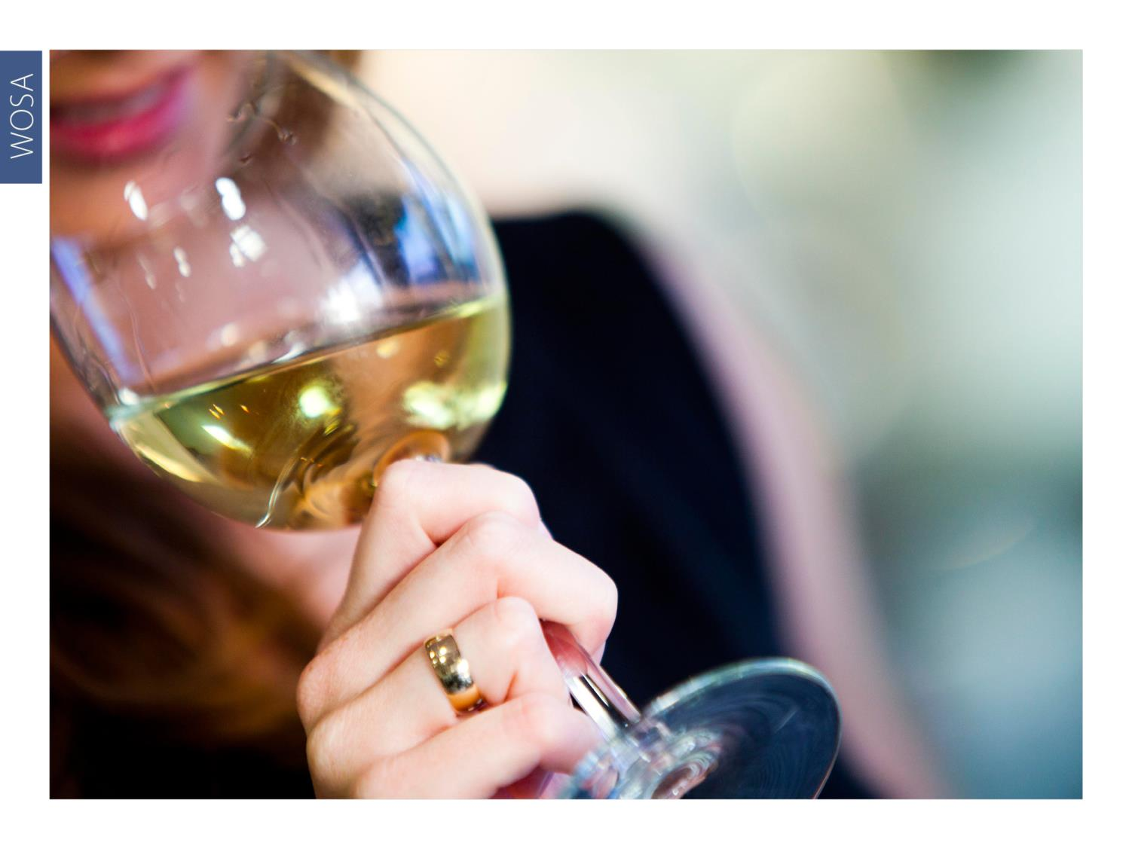
WOSA
Notes:
Today, South African wines made from this variety are being recognised internationally for their quality and complexity.

Slide 10
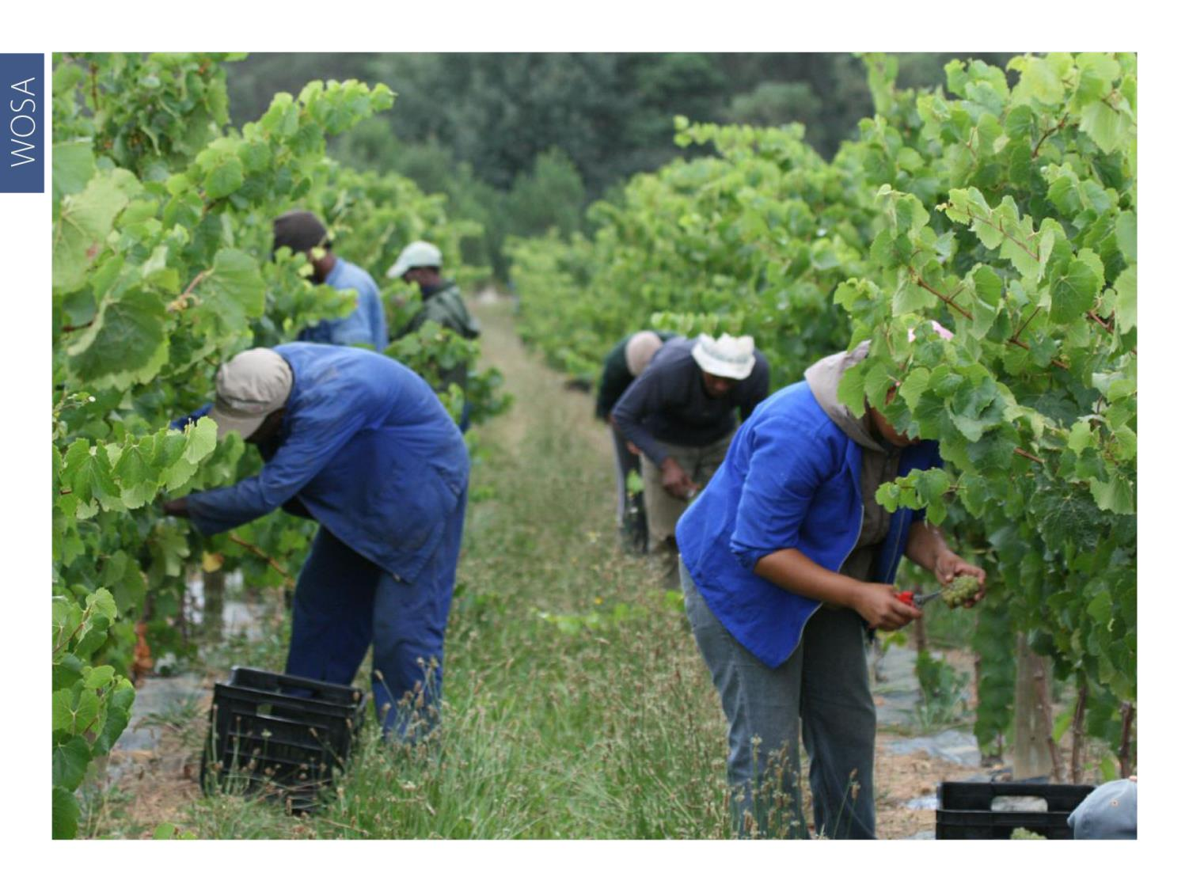
WOSA
Notes:
A wide variety of clones are available locally and some producers plant several different clones to achieve the desired flavour profile and complexity in the resultant wine.

Slide 11
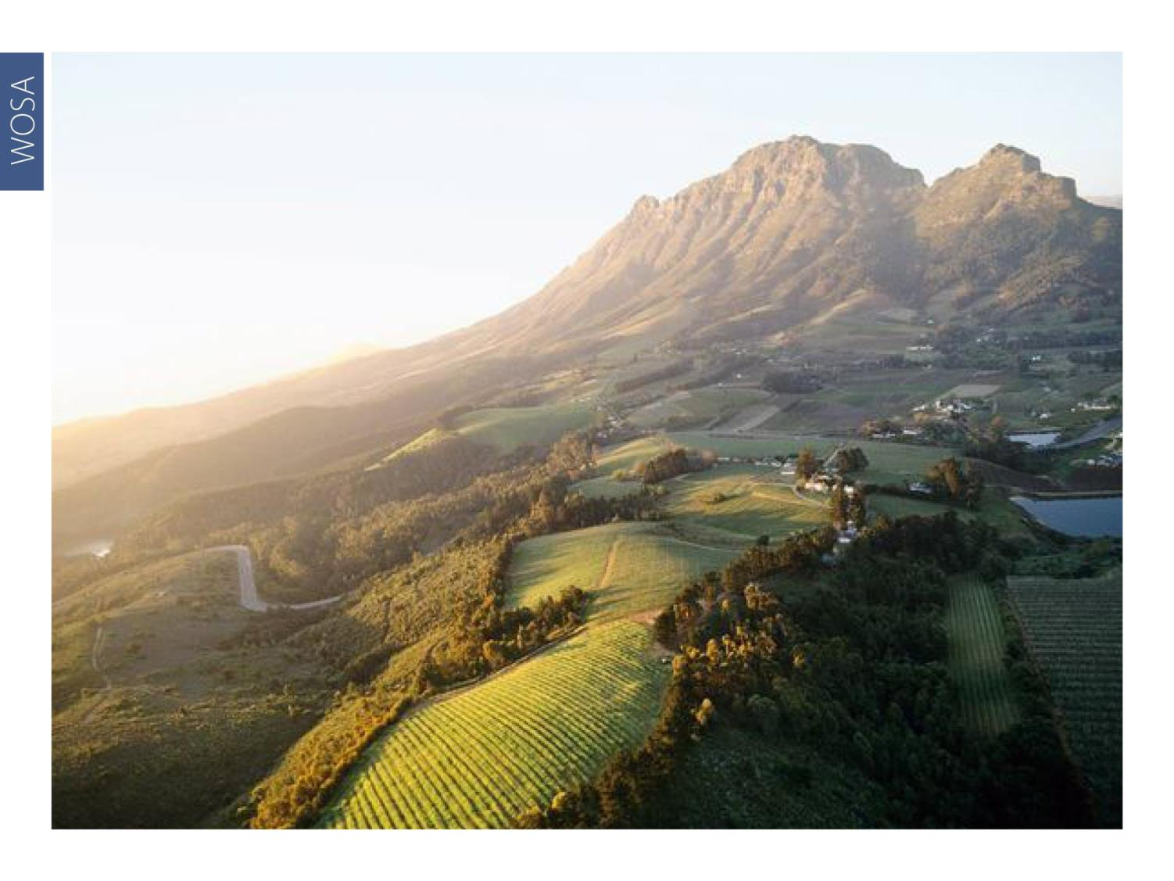
WOSA
Notes:
Sauvignon Blanc is the second most planted white-wine variety in South Africa, with total plantings at the end of 2023 accounting for 10 028 ha (11.4% of the national vineyard).

Slide 12
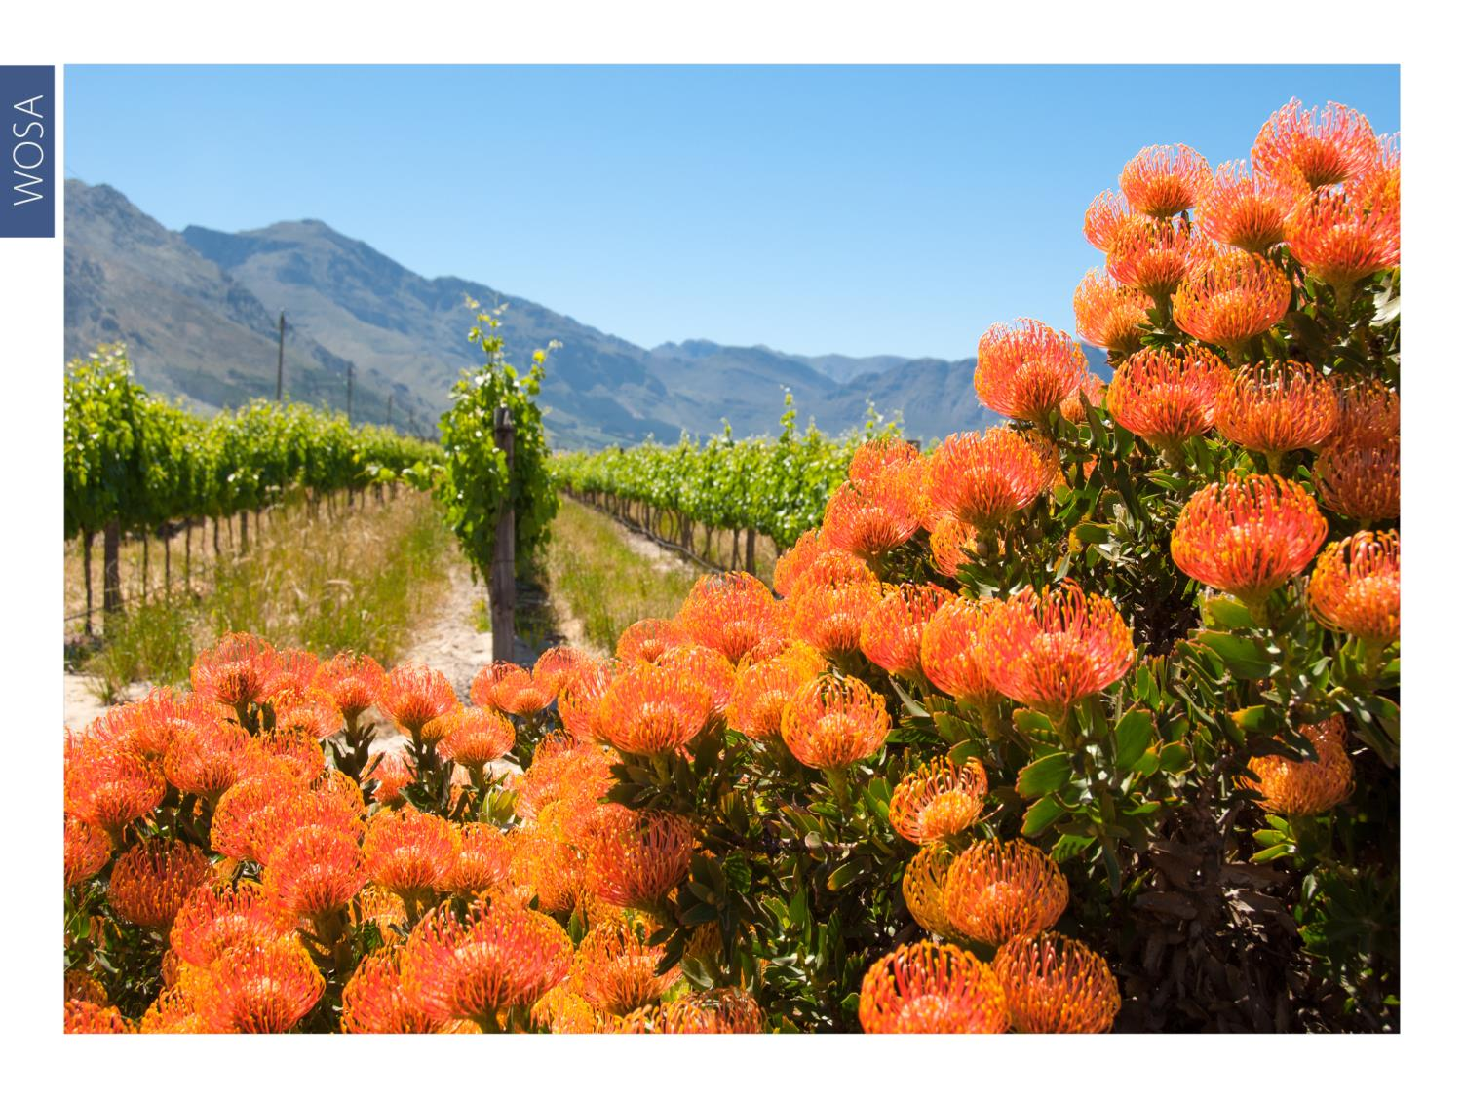
WOSA
Notes:
Sauvignon is produced in most of South Africa’s diverse winegrowing regions. For Sauvignon that displays pure, clean fruit and fresh acidity, the production areas of Cape Point, Constantia, Darling, Durbanville, Elgin and Elim, as well as the as yet unclassified Schapenberg in the Stellenbosch district lead the way.

Slide 13
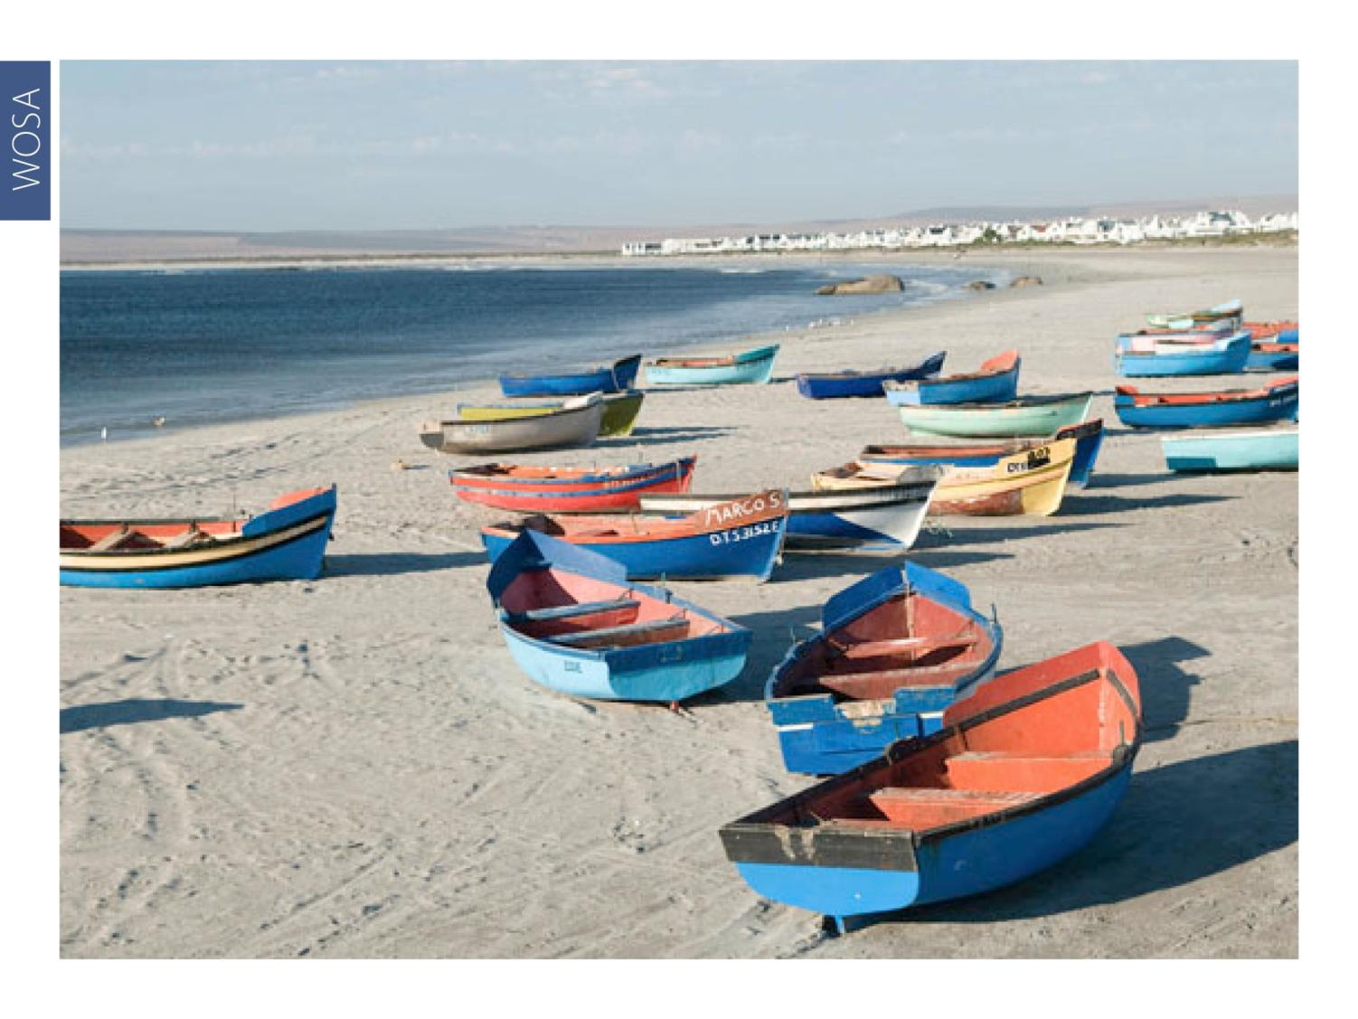
WOSA
Notes:
Fine examples are also made in pockets on the West Coast, including Cederberg, Bamboes Bay and Lambert’s Bay.

Slide 14
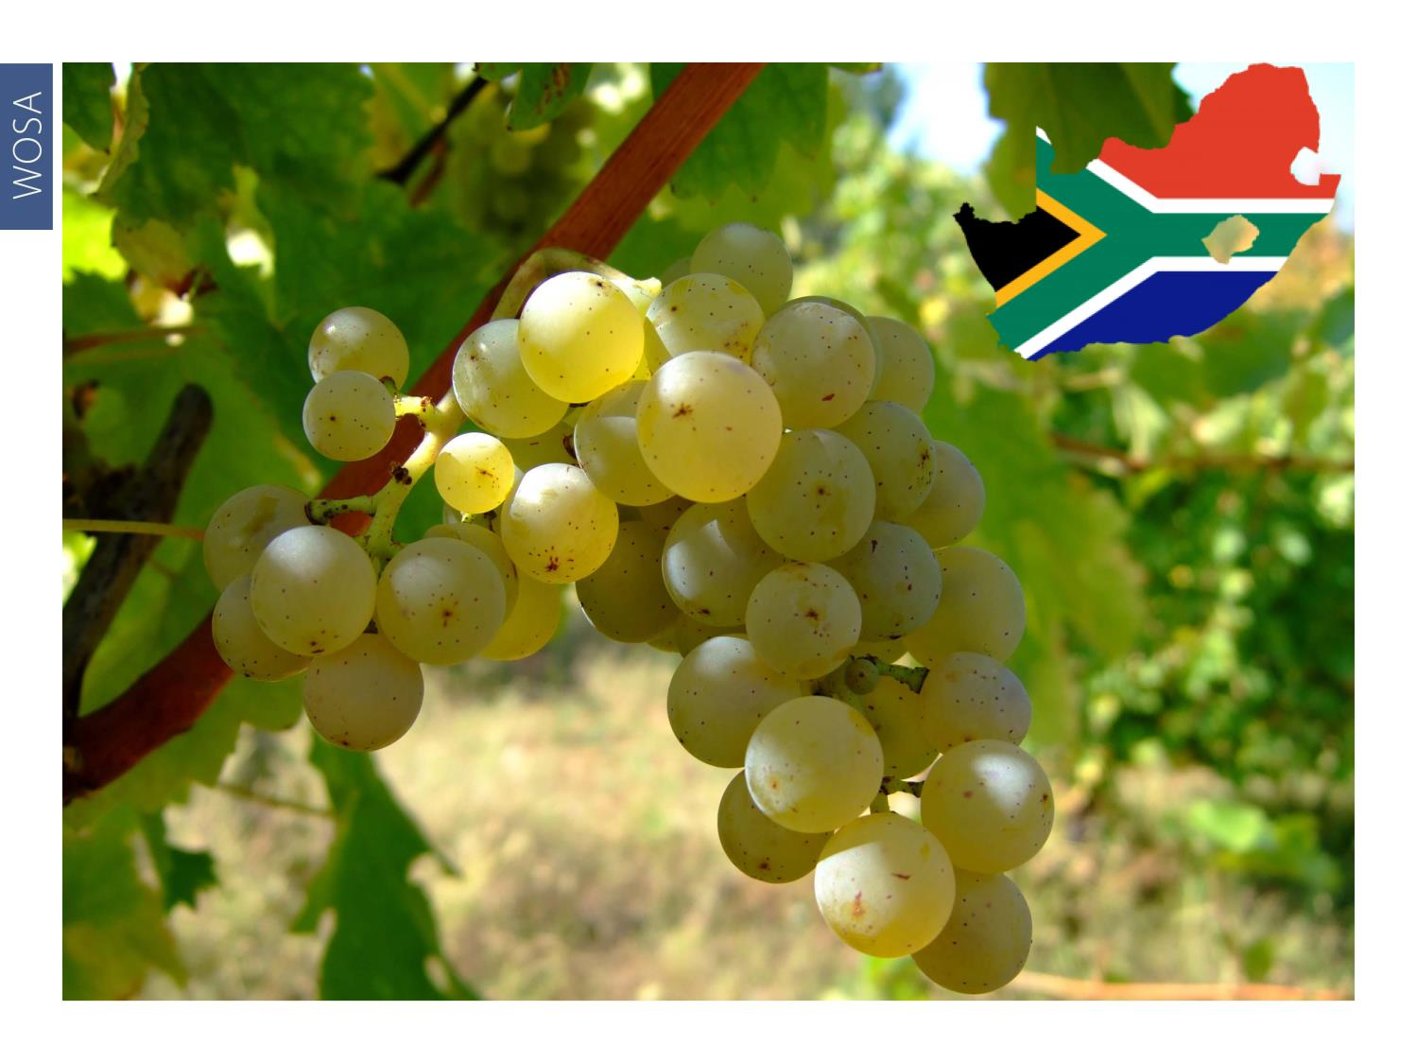
WOSA
Notes:
If the quality of South African Sauvignon Blanc was generally no more than serviceable just over a dozen years ago, it is now one of South Africa’s strongest categories, having benefited in particular from the modern quest to identify more cool-climate vineyard sites.

Slide 15

WOSA
Notes:
The style of South African Sauvignon Blanc has diversified to include wines with good fruit expression, in addition to the well-known grassy examples.

Slide 16
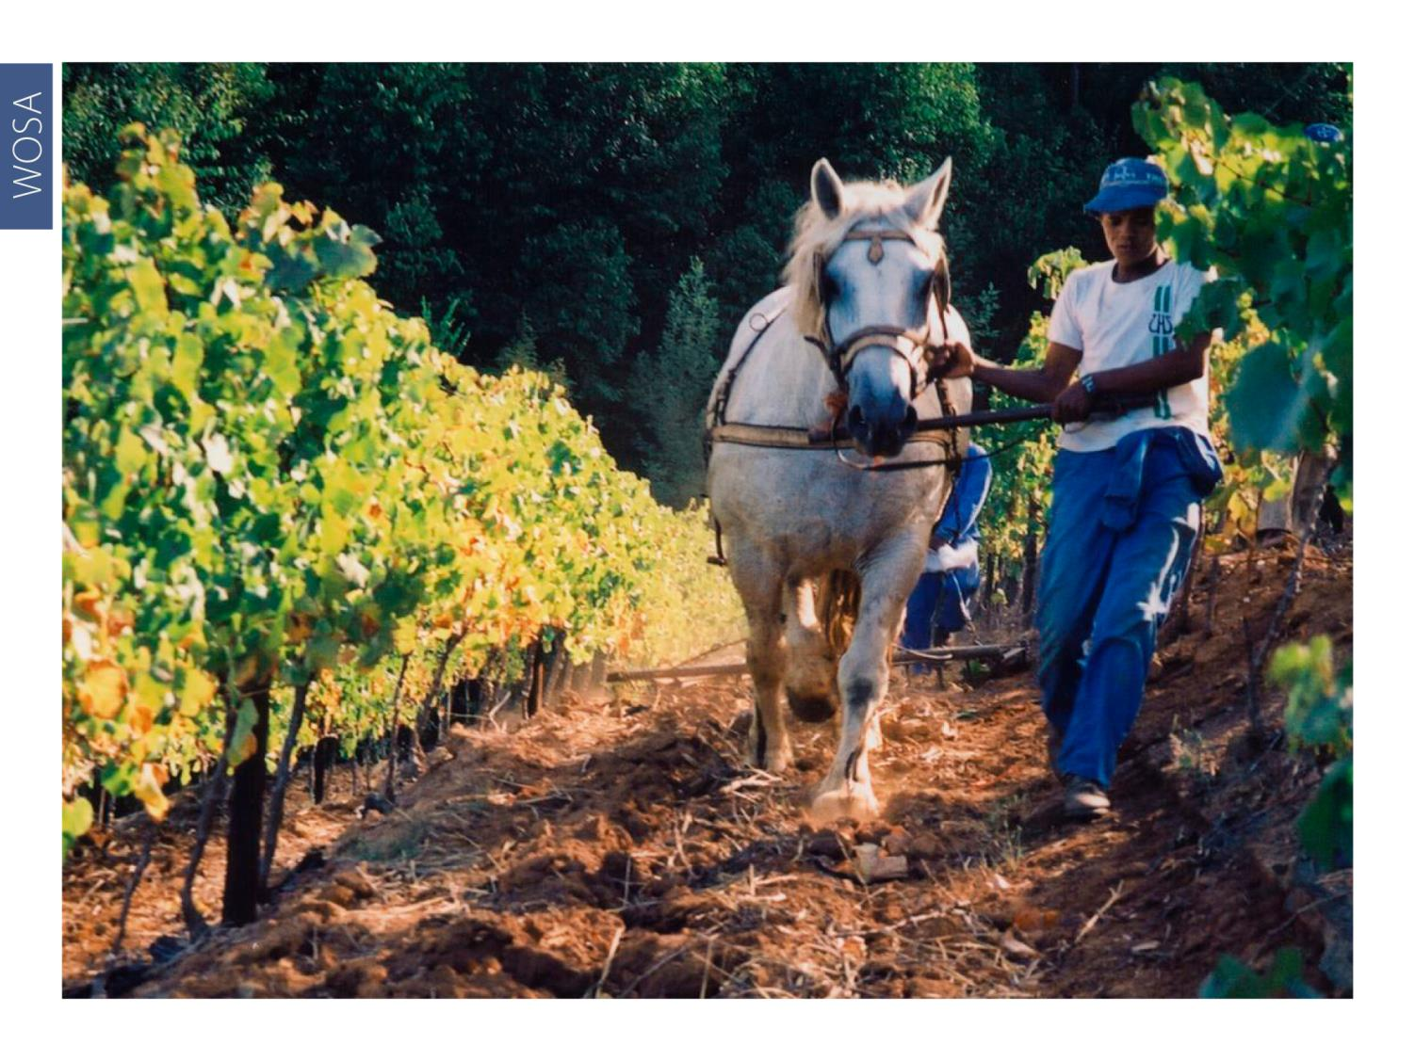
WOSA
Notes:
Balanced fruit acids are a sought-after attribute. These days South African Sauvignons are well balanced thanks to vineyards being located in areas that allow optimal ripeness.

Slide 17
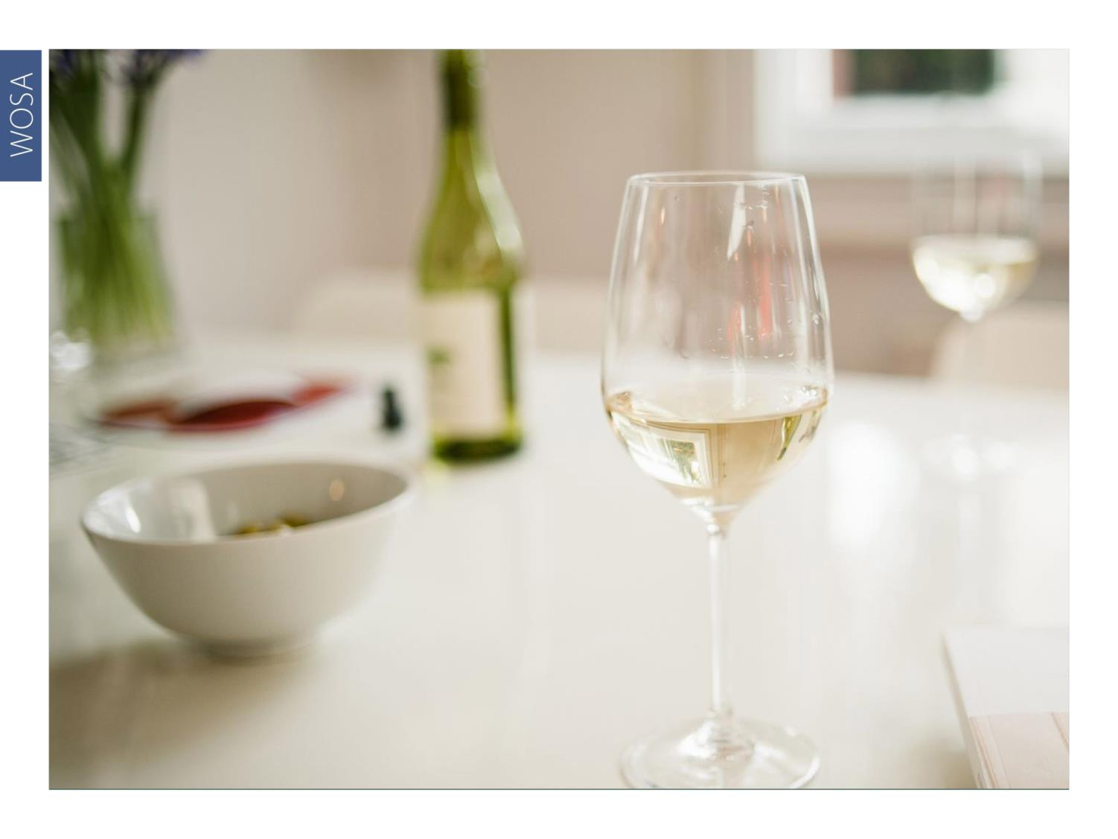
WOSA
Notes:
Sauvignon wines representing a great diversity of origins and styles are showing the true potential of this noble grape variety in South African conditions.

Slide 18
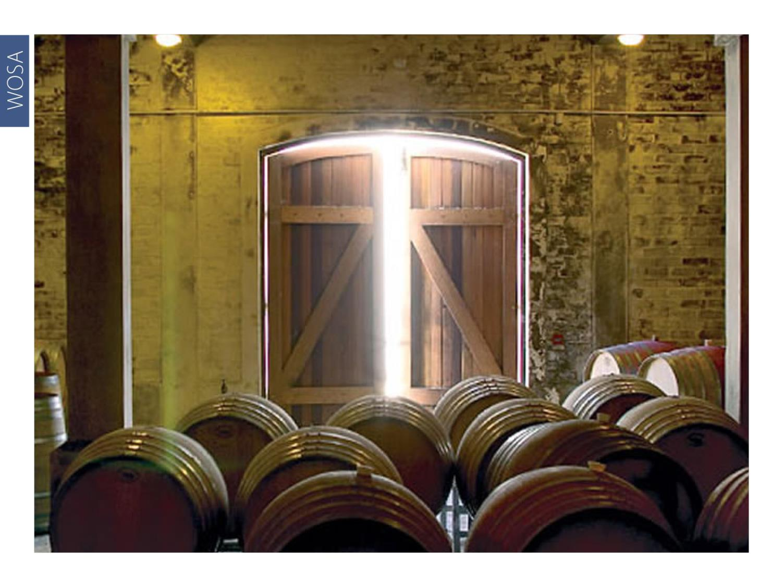
WOSA
Notes:
The wines are sometimes wooded with clever use of oak adding greater palate weight. These are labelled Fumé Blanc or Blanc Fumé.

Slide 19
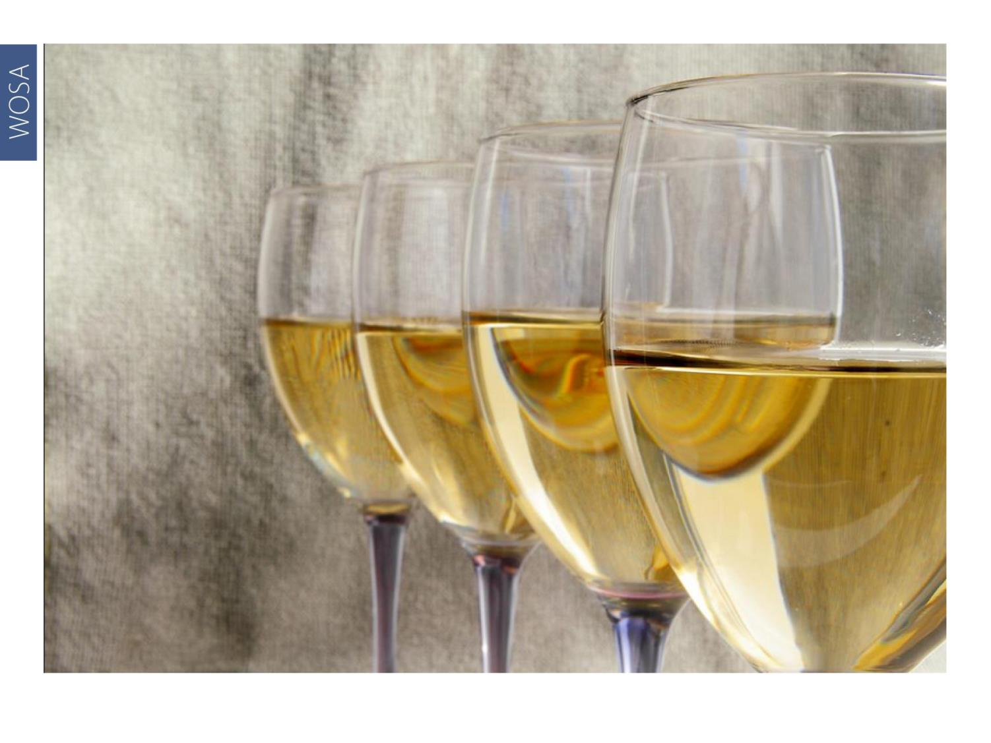
WOSA
Notes:
Sauvignon Blanc also features in white blends, including in a typically Bordeaux-style blend with Semillon, or a number of other varieties including Chardonnay and Chenin Blanc.

Slide 20
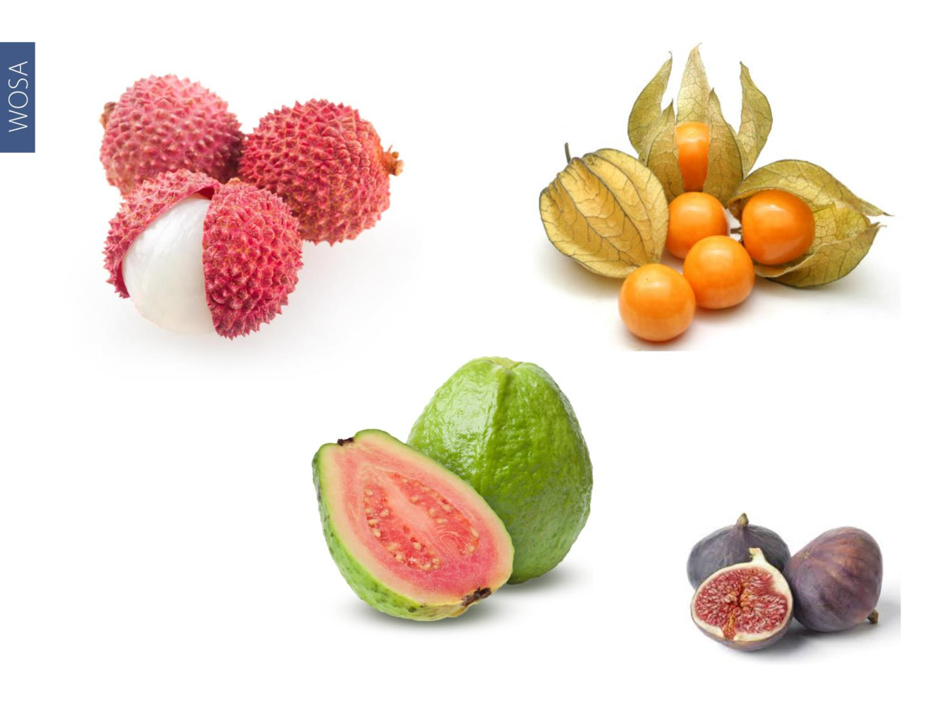
WOSA
Notes:
Flavour profiles vary from fruit-forward wines – fig and gooseberry or more tropical tones such as guava and litchi – to a distinctive green peppery or grassy character and the more linear flinty and mineral examples.

Slide 21
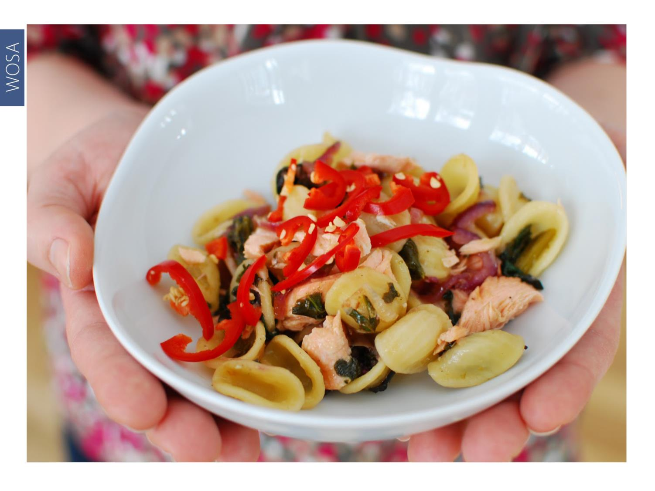
WOSA
Notes:
Sauvignon works well with a wide range of dishes, from Mediterranean-style appetisers to fish and shellfish dishes and seafood salads, roast chicken or chicken pie, or pasta with pesto.

Slide 22
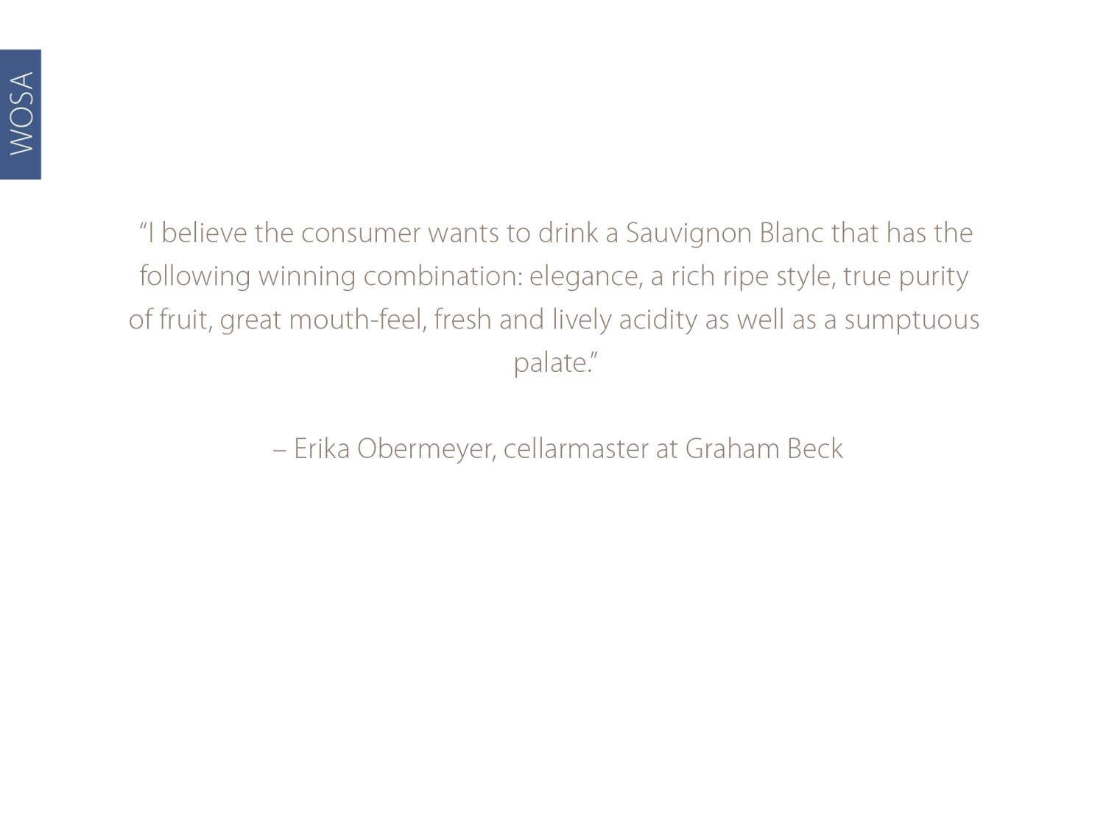
WOSA
Erika Obermeyer, owner/winemaker at Erika Obermeyer Wines

Slide 23
WOSA
THE END

